Slide 1
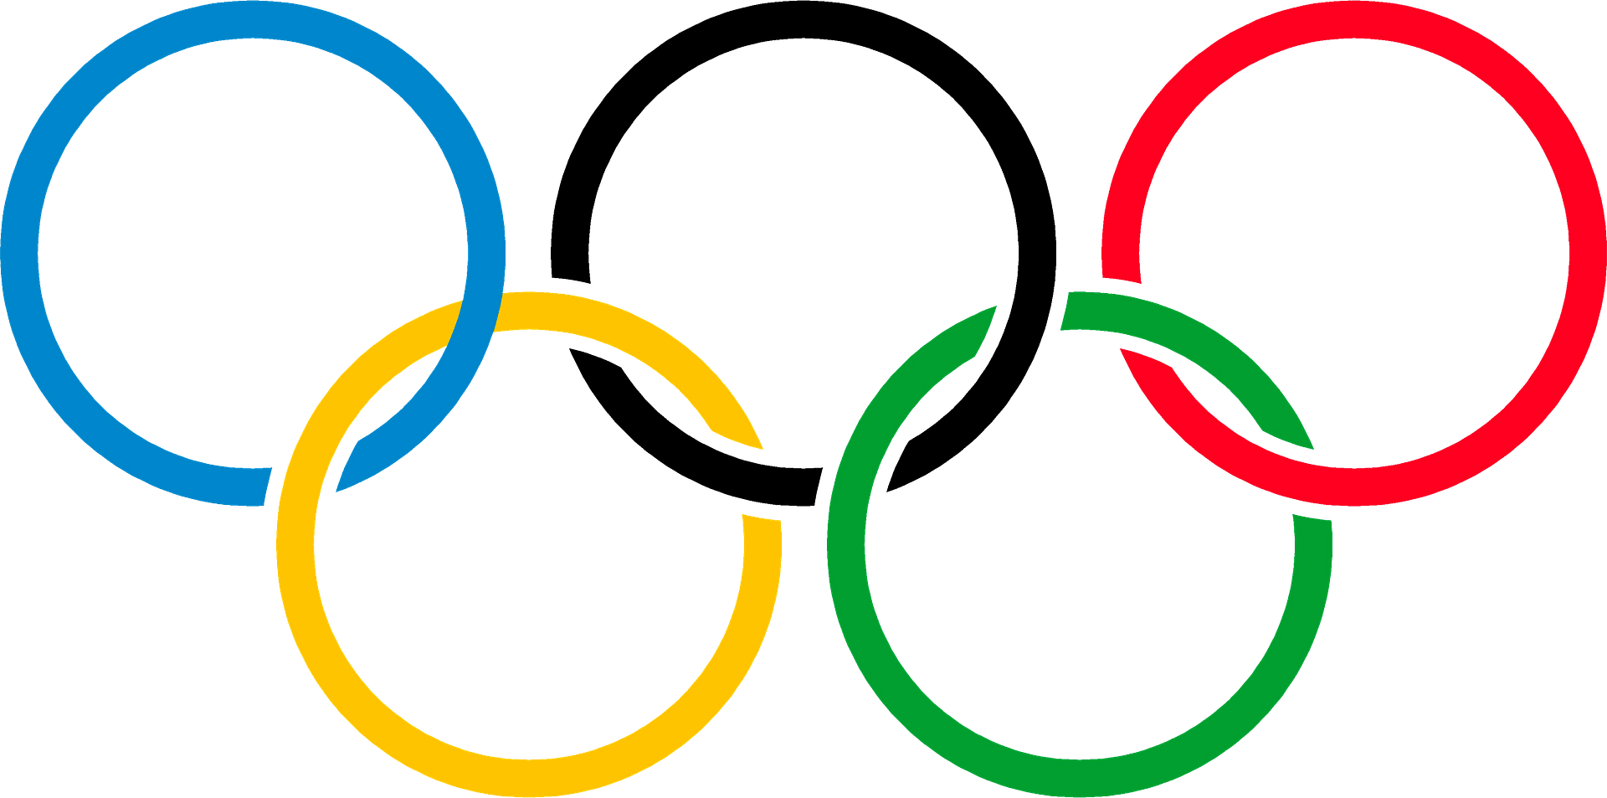
My SQL Capstone Project:
SportStats

Slide 2

Table of Contents:
Review of Questions to Answer/Hypotheses/Approach
Technical Challenges
Initial Findings
Deeper Analysis
Hypotheses Results

Slide 3
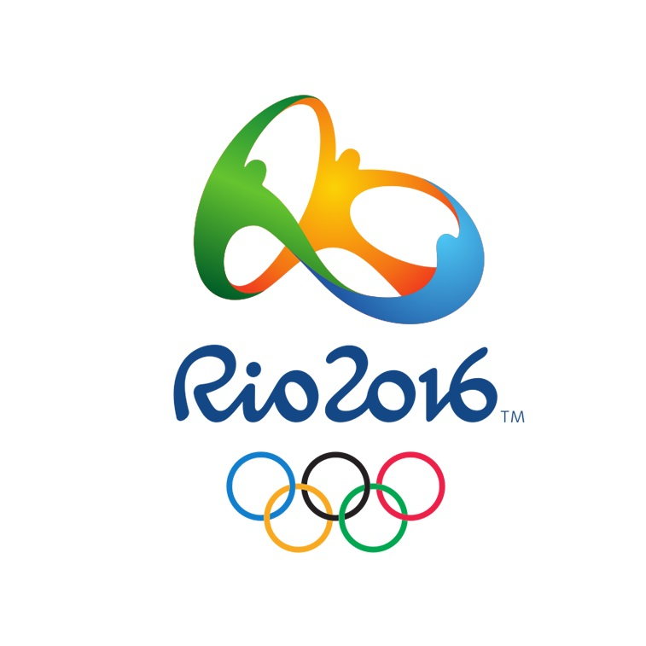
1. Questions to Answer
Has the rate between men and women changed over time according to historical Olympics Events?
What are the countries that historically have been the most successful in Olympic games?
What sports have the most number of participants?
What is the ideal age to participate in Olympics according to history?
. Questions to Answer

Slide 4

Section 2 Initial Hypotheses
Hypothesis #1: Yes it has changed over time.
Hypothesis #2: United States of America, Russia and China
Hypothesis #3: Athletics, Football and Gymnastics.
Hypothesis #4: Between 22 and 25 years of age.

Slide 5
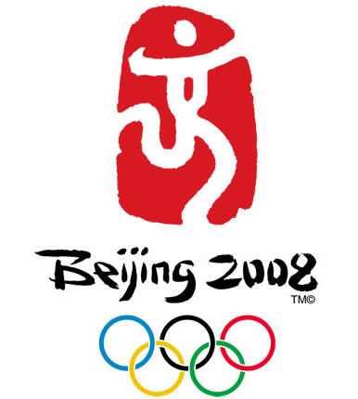
Section 3: Data Analysis Approach
Approach #1: Build a line graph that shows the progress of the ratio over the course of the years. Calculate differences.
Approach #2: Draw a histogram that utilizes the relevant and adequate parameters to get the expected results.
Approach #3: Calculate the total players per sport.

Slide 6
Technical Challenges
Dataset is not very well treated or organized. External programs like Power BI will be used to transform data.
A lot of values in the Dataset are not available.
My PC is very slow.

Slide 7
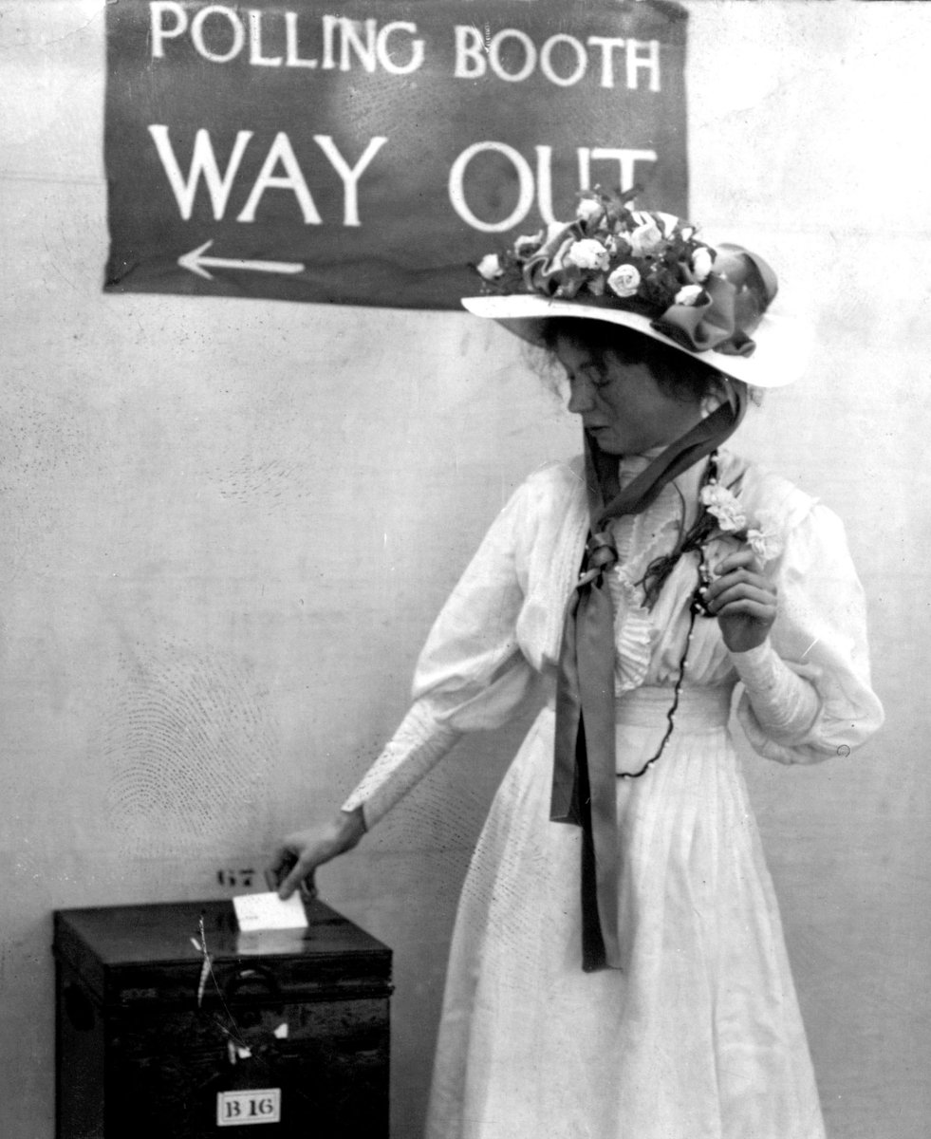
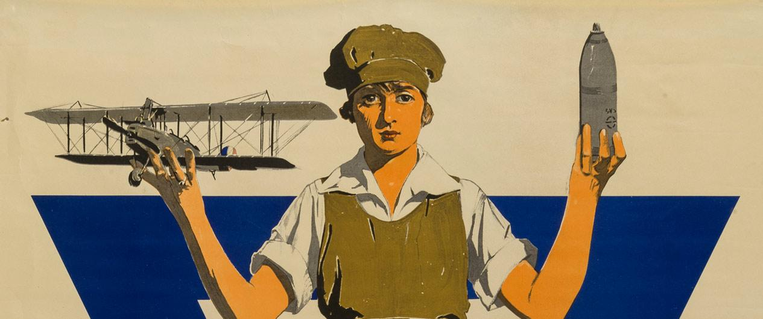
Initial Findings
Since the very first Olympic games back to 1896, men were very dominant in relationship with women. In those Olympic games more than 90% of the participants were males. We are talking about a huge number. This Data is related to history as women in this decades did not have much participation in most events. After the Great War, women started having the importance they deserve in society, this is super related to our Olympic Statistics.

Slide 8

As you can see in the graph, the ratio of Female participation has grown a from 4% on 1896 to nearly 45% on Rio 2016. The gender equalization has stabilized over time. This suggests that our initial hypothesis is correct and that our World is changing to a much better place.

Slide 9
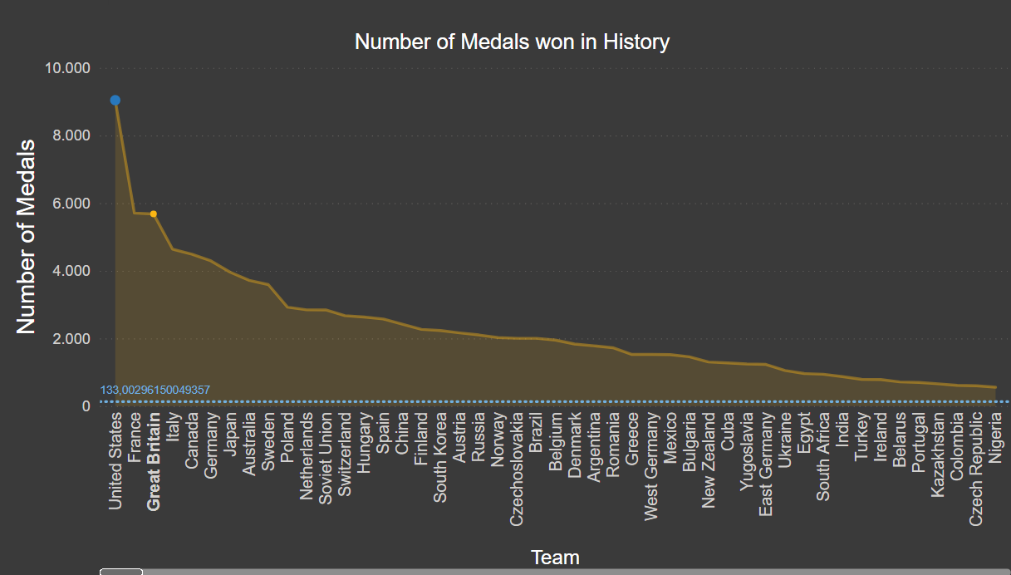

Initial Findings II
The area chart indicates that by far the country with the most quantity of medals won in history is USA with around 9k medals. Behind are France (5.7k) , Great Britain(5.7k) and Italy. China is actually in the 16th place with 2400 medals.

Slide 10


Initial Findings III
As the graph indicates, Athletics is the most participated sport in Olympics lifespam with 21,883 participants. I consider the reason for this finding is because athletics is one of the first sports to be played (776 BC) so it´s very famous. Football is actually in 4th place and Gymnastics in 10th place which is close to my initial hypothesis. They are all in the Top 10.

Slide 11
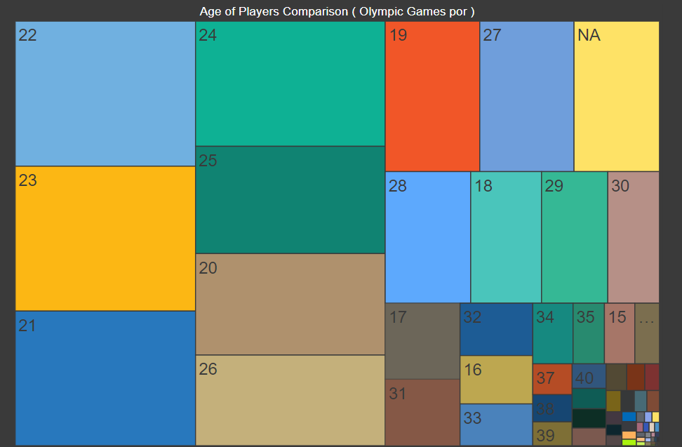
Initial Findings IV
My assumption seems to be correct. Most participants of Olympics Games are between 22 and 25 years old. This may be because most professional athletes are developed during this segment of years. As a cool fact the youngest athlete to participate was 10 years old (Athletics) and the oldest was 71(Shooting).

Slide 12
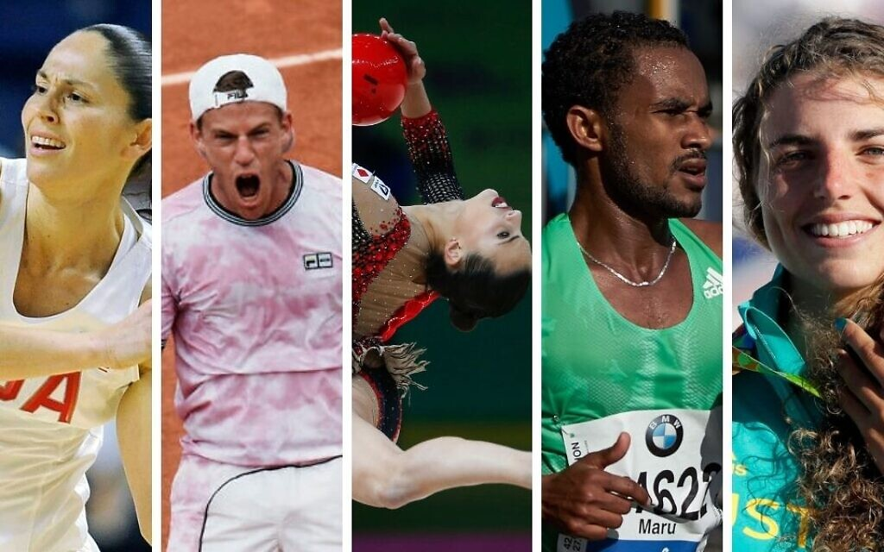
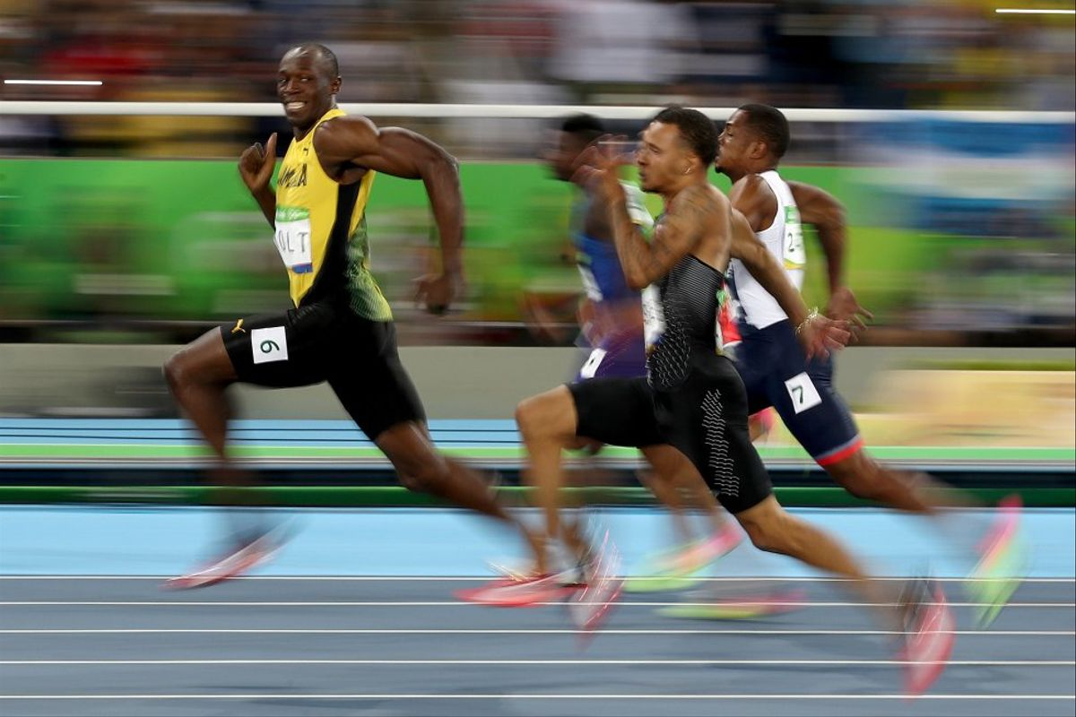
Deeper Analysis
There is a particular trend line drawn at the Initial Findings II (Slide 8) regarding the number of medals by country. This line shows the average medals won by all countries in the course of history. As you can see, the top 3 countries have 50 times the amount of medals of all the countries. This is an amazing statistic because it shows how some countries try hard to have success, while others not so much.

Slide 13
Result of Hypotheses
Yes, the performance of a country in winter Olympics is highly correlated to that in summer Olympics
Yes, the country performance by year change more in Winter Olympics than that in Summer Olympics.
The male:female ratio has decreased from 1896 t o 2016

Slide 14


